Slide 2

Notes:
Cover Slide

Slide 3
WHAT’S NEW IN SIMULATION
Terence Woo
Product Manager - FEA
Notes:
Title Slide

Slide 4




HOUSEKEEPING FOR ATTENDEES
How this Session Works:
You’re on mute: All attendees are muted with video off.
Q&A: Drop questions in the Q&A Tab—they may get lost in the chat.
Chat: Say hello or share ideas in the Session Chat. (We’re watching!)
Resources & Replays:
Download Resources: Check the Resources tab for downloads, links and session content.
Replay: All session recording will be available on the Hawk Ridge Systems website.
Zoom Events Navigation:
Find Sessions: Use the Sessions Tab or My Agenda
Experience Hub: Open from 10:40 AM to 11:15 AM PST to hear directly from our partners for lightning sessions.
Let’s Get Started!

Slide 5
Which simulation tools do you use?

Slide 6
Which version are you currently using?

Slide 7


What’s New?
SIMULATION
PLASTICS
FLOW SIMULATION
Notes:
Agenda

Slide 8
What’s New?
SIMULATION
PLASTICS
FLOW SIMULATION
Notes:
Agenda

Slide 9
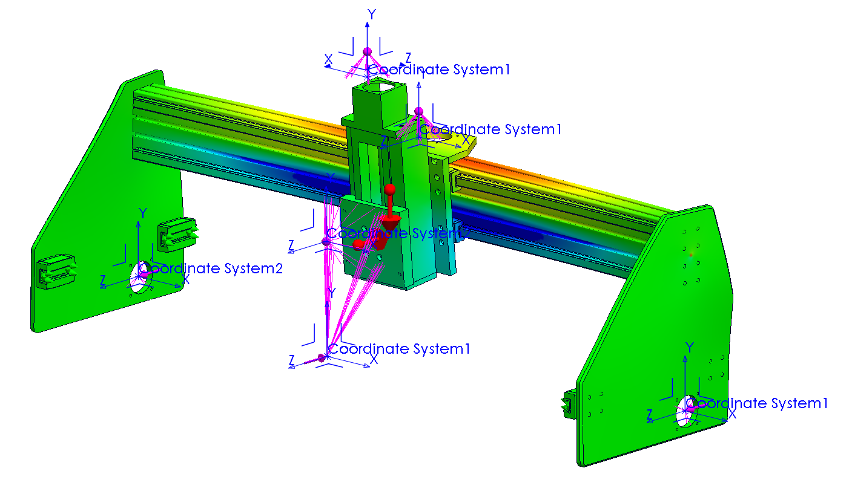
What’s New in SOLIDWORKS Simulation
Angular Displacement Plots
Plot rotational displacement in degrees or radians
Default Shell Type
Assign a default shell type in the Simulation Options
Streamline shell definition between thin/thick shells
Distributed Remote Load on Shell Edges
Distributed coupling formulation for remote load/mass now supports shell edges
Allows better representation of loading conditions when working with shell elements
Notes:
Agenda

Slide 10
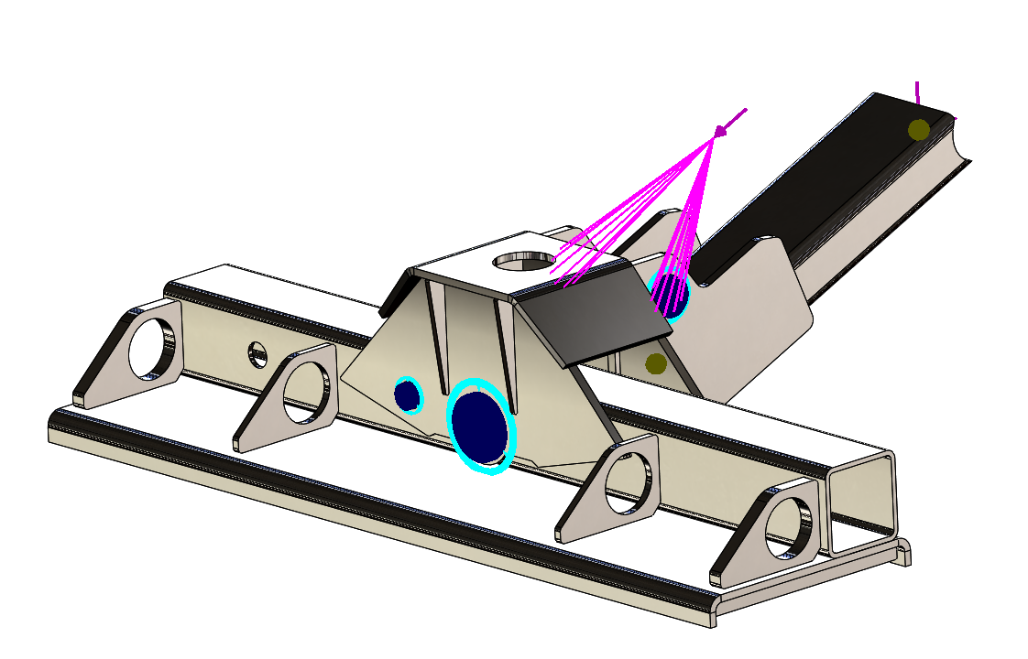
What’s New in SOLIDWORKS Simulation
UX Improvements for Validity Checks
Bodies with missing materials listed in error message
Failed mesh control bodies listed in error message
Pin Connector Forces for Random Vibration
Extract shear force, axial force, bending moment, and torque for pins in random vibration studies
Notes:
Agenda

Slide 11
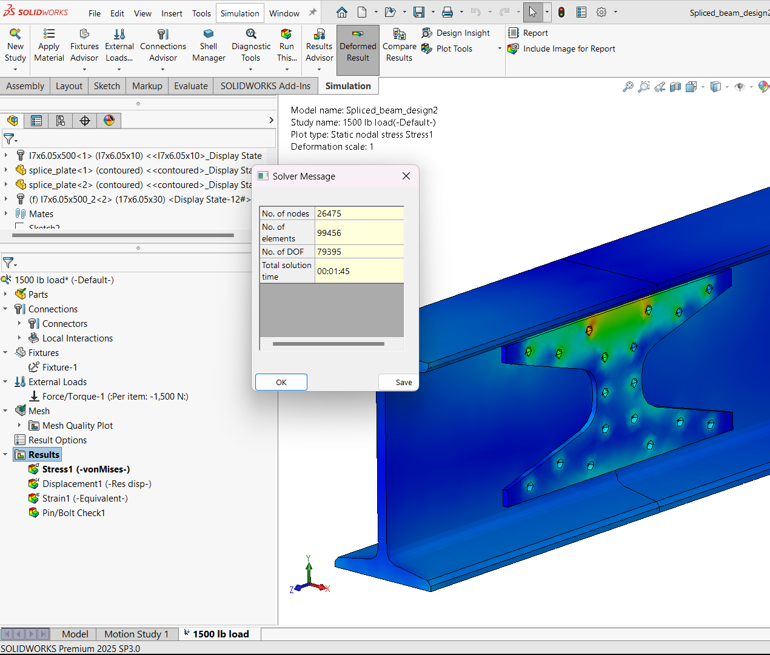
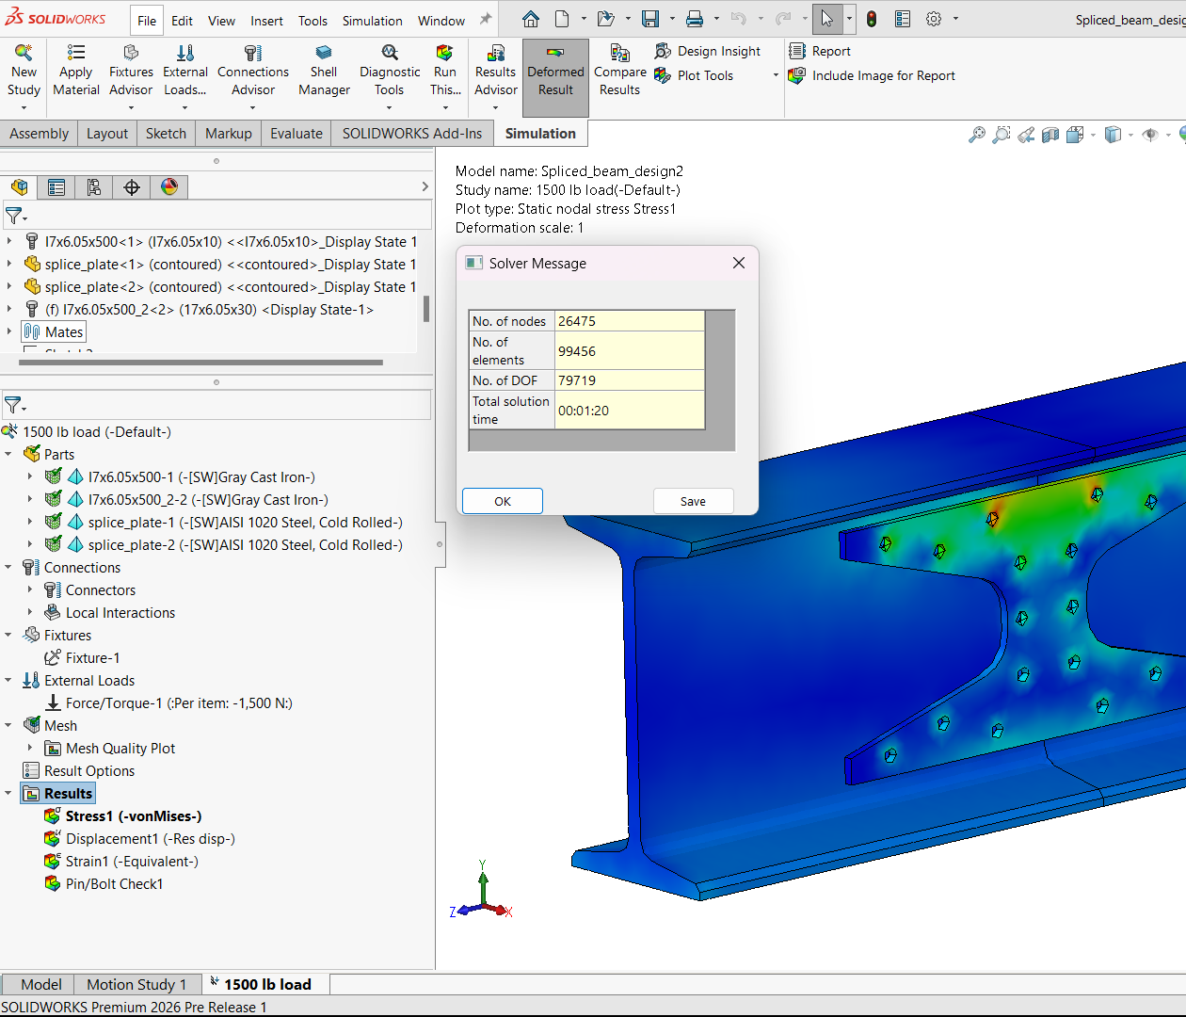
What’s New in SOLIDWORKS Simulation
Performance Improvement for Connectors
Decreased simulation run times with bolts, rods, and bearing connectors
2025 SP3 – 01:45
2026 PR1 – 01:20
Notes:
Agenda

Slide 12
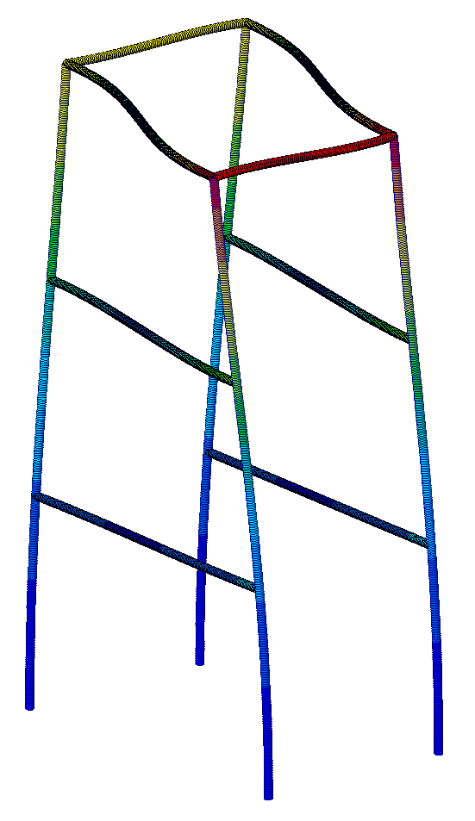
What’s New in SOLIDWORKS Simulation
Total Option for Beam Forces
Simplifies beam load definition when multiple beams are selected
Remote Mass for Response Spectrum Analysis
Streamlines seismic analysis by replacing complex parts with simple lumped masses
Filter Buckling Modes
Extract only positive buckling modes to focus on the most relevant results
Notes:
Agenda

Slide 13
What’s New?
SIMULATION
PLASTICS
FLOW SIMULATION
Notes:
Agenda

Slide 14
What’s New?
SIMULATION
PLASTICS
FLOW SIMULATION
Notes:
Agenda

Slide 15
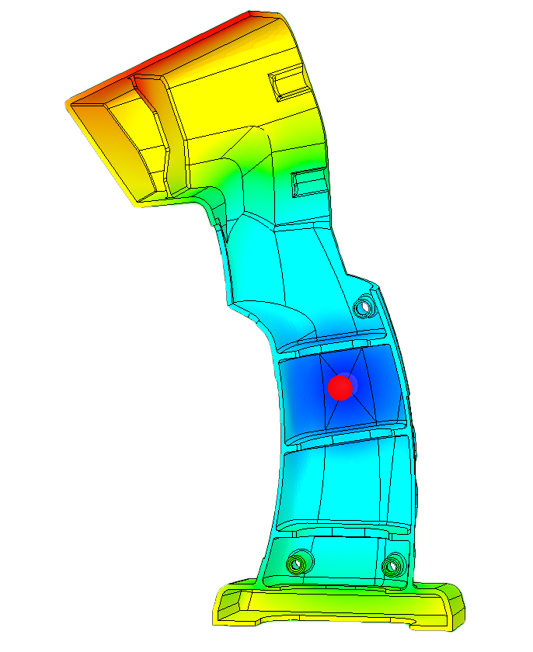
What’s New in SOLIDWORKS Plastics
Material Database
85 new materials have been added
12 material classes have been updated
Solver Performance
Fill solver performance increase up to 15%
Pack solver performance increase up to 30%
Cool solver performance increase up to 25%
Unfilled Volume Plot
New default plot result when a short shot is detected
Visualize unfilled regions to identify and resolve short shot issues for higher-quality parts
Notes:
Agenda

Slide 16
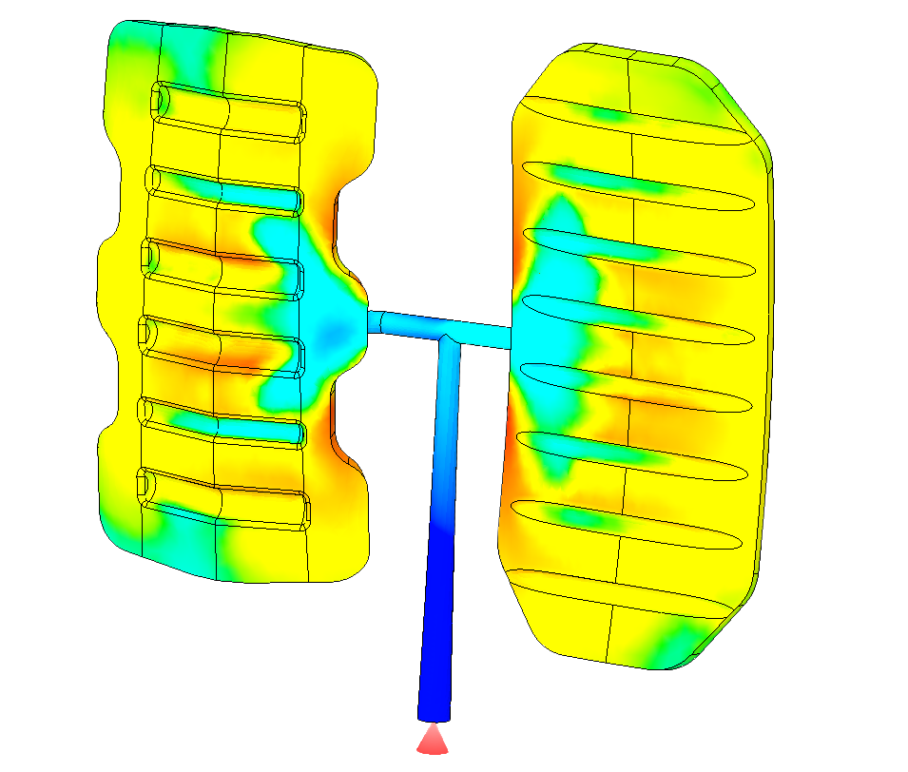
What’s New in SOLIDWORKS Plastics
Edge Venting Analysis
Specify edges for air vent analysis
More realistic representation of actual mold venting for more accurate venting pressure results
Thermoset Materials
Reactive control type changes
“Conversion” is renamed “Curing-based”
“Time” is renamed “Time-based”
New parameter for Volume % above Target Curing Level at Ejection
Sets a threshold that determines ejection
Notes:
Agenda

Slide 17
What’s New?
SIMULATION
PLASTICS
FLOW SIMULATION
Notes:
Agenda

Slide 18
What’s New?
SIMULATION
PLASTICS
FLOW SIMULATION
Notes:
Agenda

Slide 19
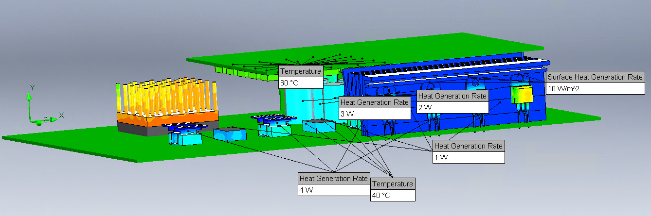
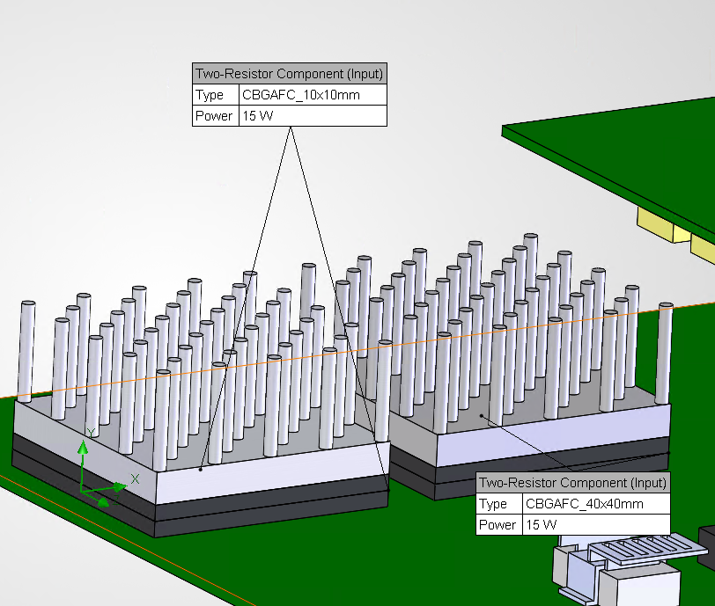
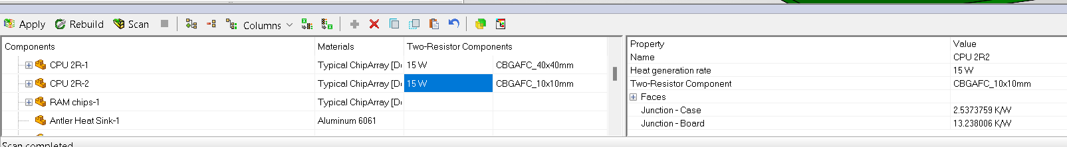
TOTAL POWER OF SURFACE SOURCES
Component explorer introduces a new Surface Source column to help summarize all surface sources and their power budgets
Shows the sum of sources of Heat Generation Rate type and number of the rest sources
TWO-RESISTOR CREATION
Component explorer supports two-resistor features automatically
Create two-resistor features one of two methods:
Specify power or EDB item, then apply to automatically create the feature
Import from EXCEL

Slide 20
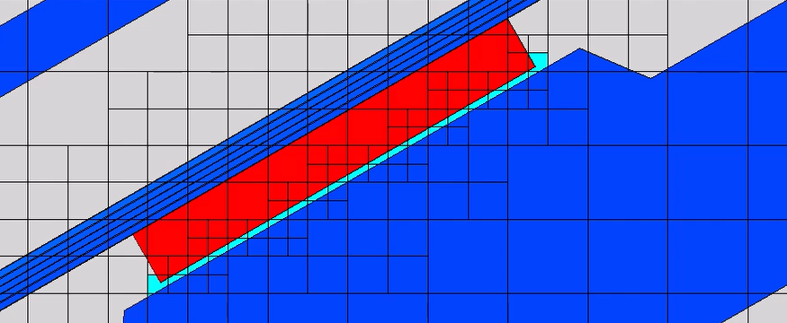
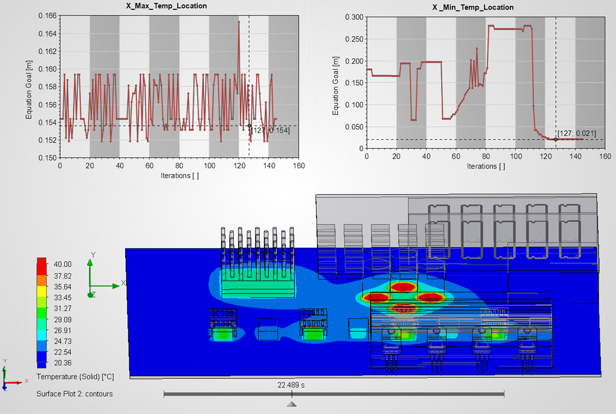
FILL THIN SLOT FEATURE
Fill mesh cells inside the gap with specific solid material automatically in accordance with thickness criteria value
Material is applied to mesh cells directly without creation of a CAD body, so the resulting shape of filler material can only be visualized with postprocessing tools
MINIMUM AND MAXIMUM GOALS’ LOCATIONS
Coordinates of a point where minimum/maximum parameter values are reached can be determined for volume or surface goals
GoalLocationX({Goal Name})
GoalLocationY({Goal Name})
GoalLocationZ({Goal Name})

Slide 21
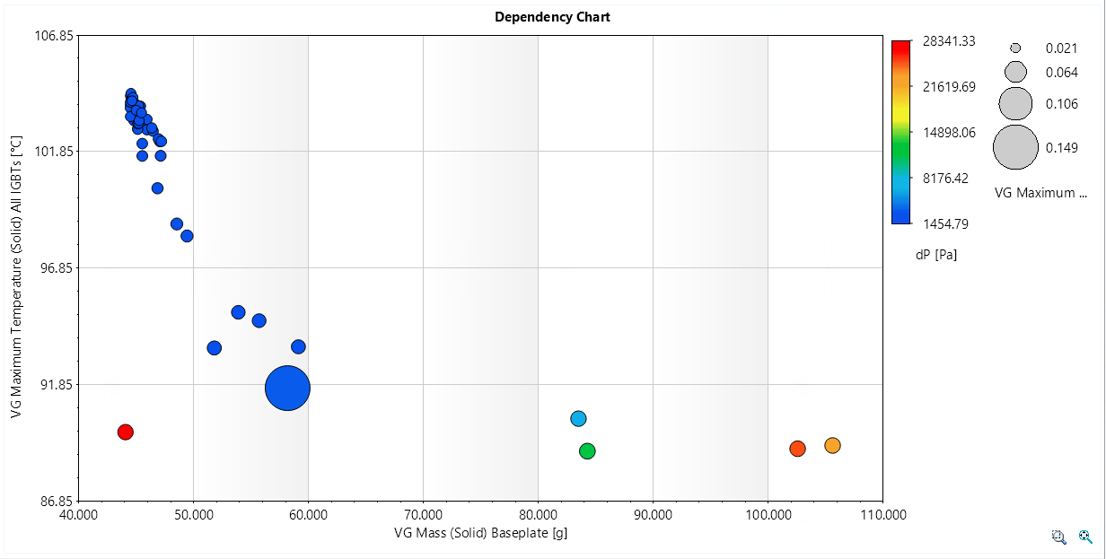
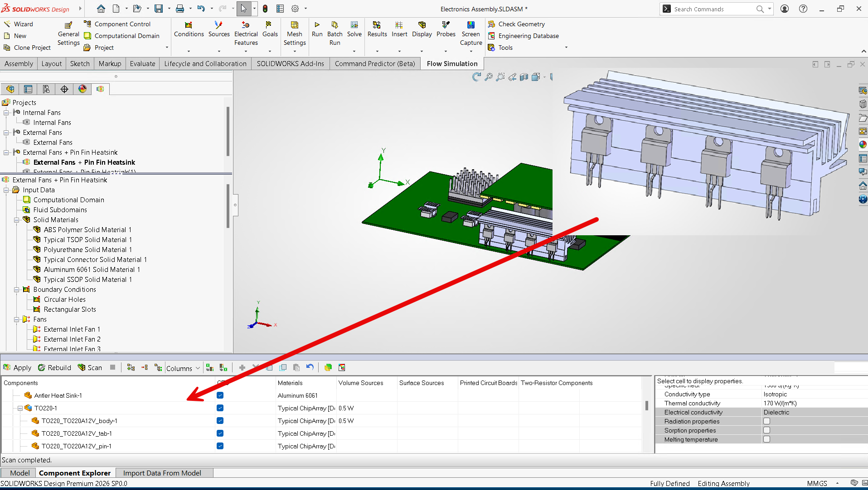
BUBBLE CHART FOR PARAMETRIC STUDY
Compare design points of resulting parametric studies through bubble chart visualization
PROJECT PARAMETERS FROM SUBMODELS
Define project parameters in the submodels and propagate them upward to help control sophisticated dependencies defined in embedded components
Enables the creation of elaborate library component and re-use of sub-models
Adjust parameter of individual components within a group of identical embedded components

Slide 22
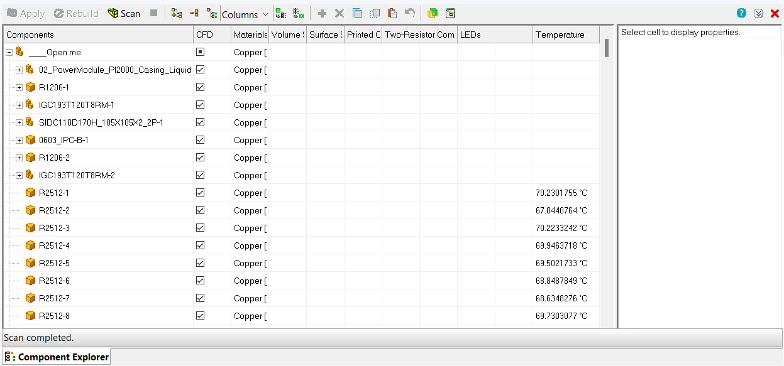
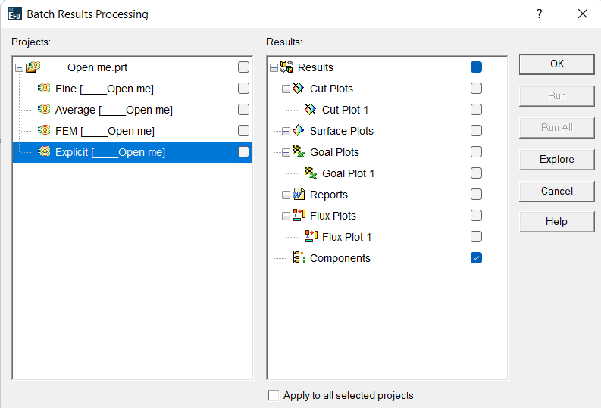
COMPONENT STATUS
A status column has been added to the component explorer tool to help simplify the user interface for viewing critical study information
Remove volume features applied to components from the component explorer
COMPONENT EXPLORER TEMPERATURE STATUS
A temperature column has been added to the component explorer that also allows users to export final values to Excel
Provides temperatures of all solids without user effort
Exports matching table of component names, input data and resulting temperatures

Slide 23
What’s New?
SIMULATION
PLASTICS
FLOW SIMULATION
Notes:
Agenda

Slide 24
What’s New?
SIMULATION
PLASTICS
FLOW SIMULATION
Notes:
Agenda

Slide 25
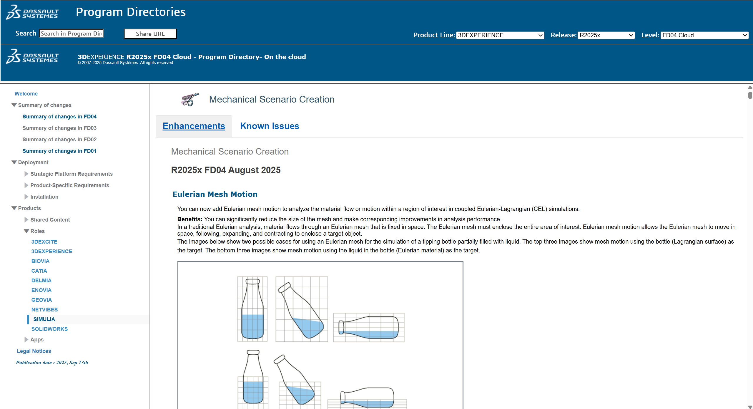
What’s New in SIMULIA
Program Directories
Enhancements in each FD release throughout the year
Documented in the Program Directories https://media.3ds.com/support/progdir/
Unified License Model
Use a shared pool of SimUnit tokens to access to Abaqus, CST Studio Suite, and more
Other license types can be converted to SimUnit licensing
Notes:
Agenda

Slide 26
What’s New?
SIMULATION
PLASTICS
FLOW SIMULATION
Notes:
Agenda

Slide 27
What’s New?
SIMULATION
PLASTICS
FLOW SIMULATION
Notes:
Agenda

Slide 28
Notes:
Cover Slide

